Slide 1

Customer churn retentions analysis project
Using excel , python , sql and power bi
Presented by
J.Joel Solomon

Slide 2
INTRODUCTION
This project focuses on Customer Churn Analysis for a telecom company. Customer churn refers to when subscribers stop using the company’s services. Churn is a critical business problem because retaining existing customers is often more cost-effective than acquiring new ones. The dataset contains information about customer demographics, services subscribed, contract type, billing, support tickets, and churn status. By analyzing these factors,
we aim to:
• Identify the key drivers of churn.
• Understand customer behavior and service usage patterns.
• Provide insights to help reduce churn and improve customer retention strategies.

Slide 3
Problem statement & Objectives
Problem Statement :
The telecom industry faces a major challenge with customer churn—the loss of clients to competitors. High churn rates lead to significant revenue loss and increased marketing costs for acquiring new customers.The company lacks a clear understanding of:
• Which customers are likely to churn
• What factors drive customer churn
• How customer service, billing, and contract terms impact retentionWithout proper analysis, it is difficult to implement targeted strategies to reduce churn and retain valuable customers.⸻
Objectives:
The main objectives of this project are:
1. Analyze customer data to identify patterns and behaviors linked to churn.
2. Examine the impact of demographics, contract type, billing, support tickets, and service usage on churn.
3. Build insights and dashboards to visualize churn trends.
4. Provide actionable recommendations to improve customer retention and reduce churn rates.

Slide 4
Work Strategy
🔹 Excel:
• Used for initial data cleaning and formatting.
• Verified missing values and ensured consistency in data types
• Performed quick summaries (pivot tables, descriptive statistics).
🔹 SQL:
• Queried the dataset to extract specific insights (e.g., churn by contract, payment method).
• Applied filtering and grouping to identify churn patterns.
🔹 Python:
• Conducted exploratory data analysis (EDA) with Pandas, NumPy, and Matplotlib.
• Identified correlations between churn and features (e.g., support tickets, contract type).
🔹 Power BI:
• Built interactive dashboards to visualize churn trends.
• Highlighted churn distribution by demographics, services, and billing. • Created storytelling visuals for actionable business recommendations

Slide 5
EXCEL:
🔹 Performed initial data cleaning (handled missing values, removed duplicates).
🔹 Checked data consistency and formatted columns.
🔹 Used pivot tables to explore churn distribution by gender, contract, and services.
🔹 Verified data quality before moving to SQL and Python

Slide 6
SQL ANALYSIS

Slide 8
PYTHON
🔹 Conducted Exploratory Data Analysis (EDA) using Pandas and NumPy.
🔹 Identified relationships and correlations (e.g., churn vs. number of tickets).
🔹 Used Matplotlib/Seaborn to visualize trends and compare churn vs. non-churn groups.
🔹 Preprocessed data for visualization and dashboards.

Slide 9
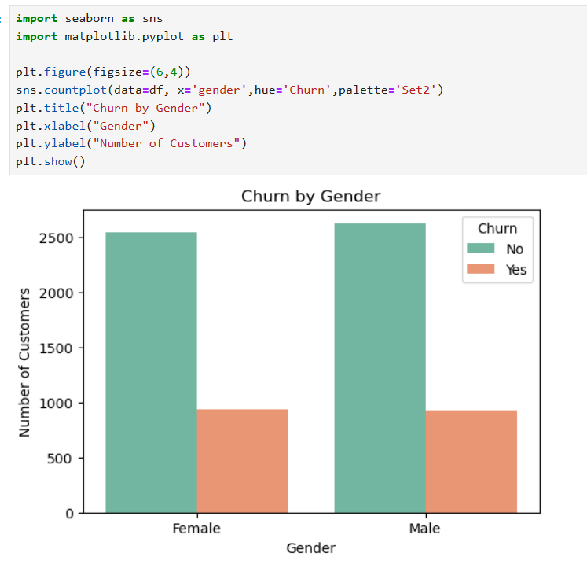

Slide 10
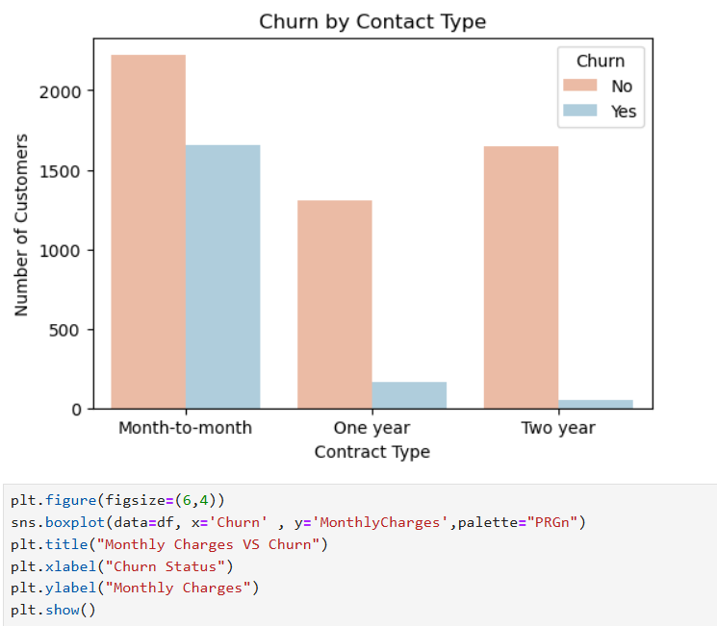

Slide 11
POWER BI:
🔹 Built interactive dashboards to visualize churn distribution.
🔹 Highlighted churn by demographics, contract type, and payment method.
🔹 Created visuals for service usage patterns and churn risks.
🔹 Designed user-friendly reports for management decision-making.
🔹 Enabled storytelling with data through compelling visual narratives

Slide 13
INSIGHTS:
• Customers on Two-Year contracts stay longer, while Month-to-Month customers are more likely to leave.
•The company is at risk of losing newly joined customers, especially those with
short tenure and on Month-to-Month contracts.
• 7043 customers analyzed: Churn Rate is ~27%.
• Monthly revenue at risk: $456.12K
• Yearly revenue at risk: $16.06M
• 2955 tech tickets and 3632 admin tickets were raised, showing service-related issues impact churn.
•Most churned customers did not subscribe to Online Security, Tech Support, or
Phone Services.
•42% of churned customers use Fiber Optic Internet, indicating dissatisfaction
with this service.

Slide 14
THANK YOU

